Slide 1
Pesticides and food safety
Supervisor:Dr Rahimifard by: melika zandi

Slide 15
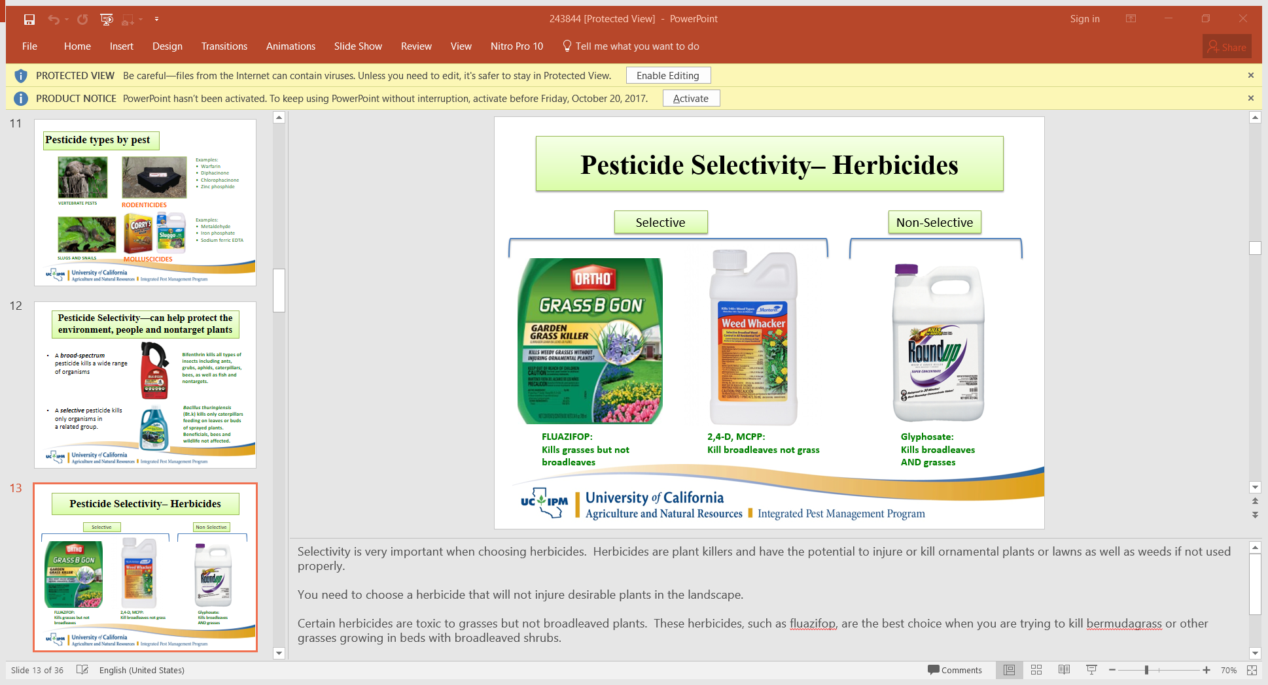

Slide 39
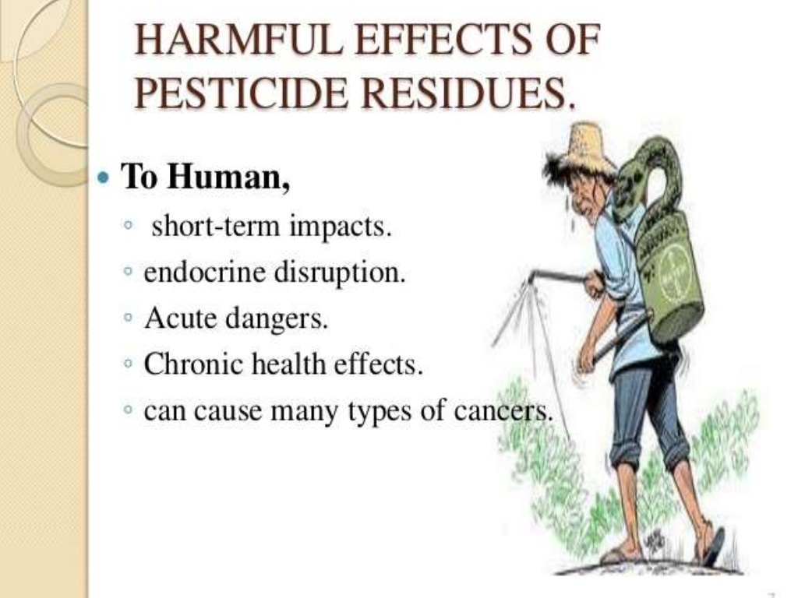

Slide 47
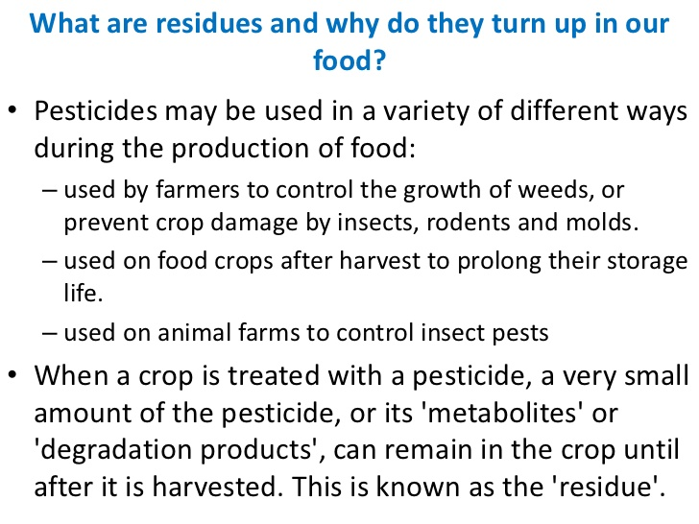

Slide 48
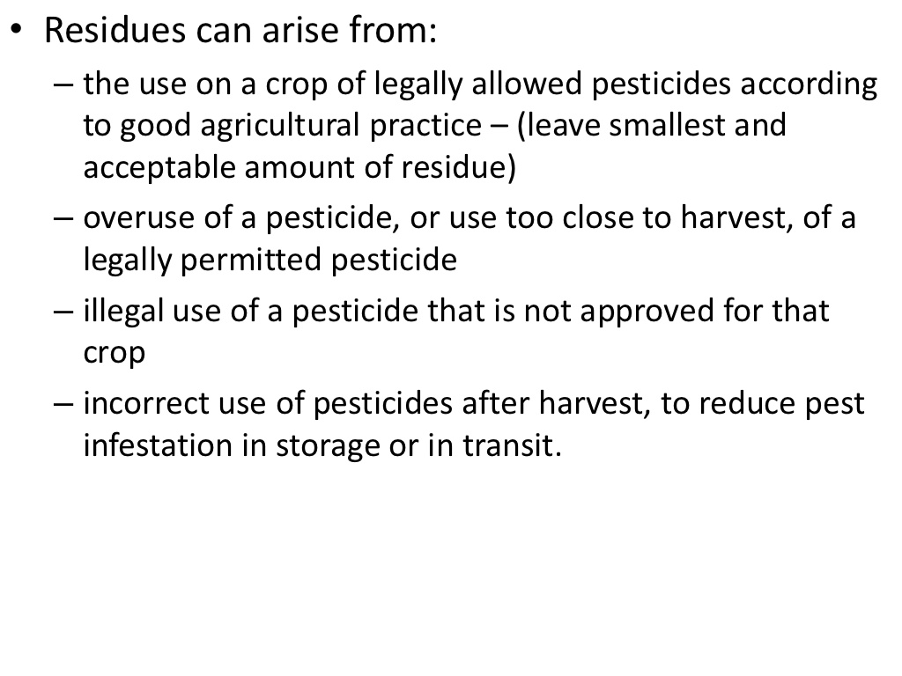

Slide 50
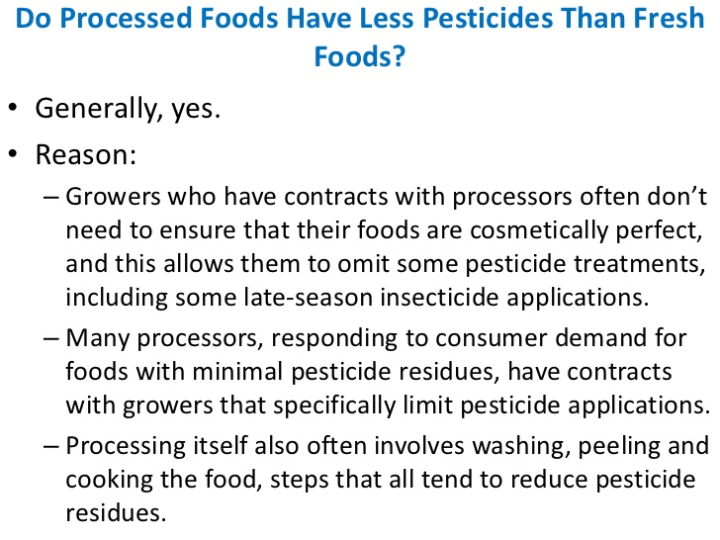

Slide 57
