Slide 1


BA TRAINING MANUAL MIDDLE EAST
1

Slide 2


AGENDA
About Adidas
About our body
Adidas Body Care Product Assortment
About Adidas Brand Architecture
  Male Fragrance Line: UEFA Range
  Male Fragrance Line
  Female Fragrance Line
  Male & Female Antiperspirants
  Male & Female Standalone Shower Gels
Competition
Target Audience
Selling Approach
CADOIDTYASPRESTIDIGITAGLES&TRAHTAEVGAYSFY/1/820//16WORERVKSIEHWOP

Slide 3


ABOUT ADIDAS
3

Slide 4
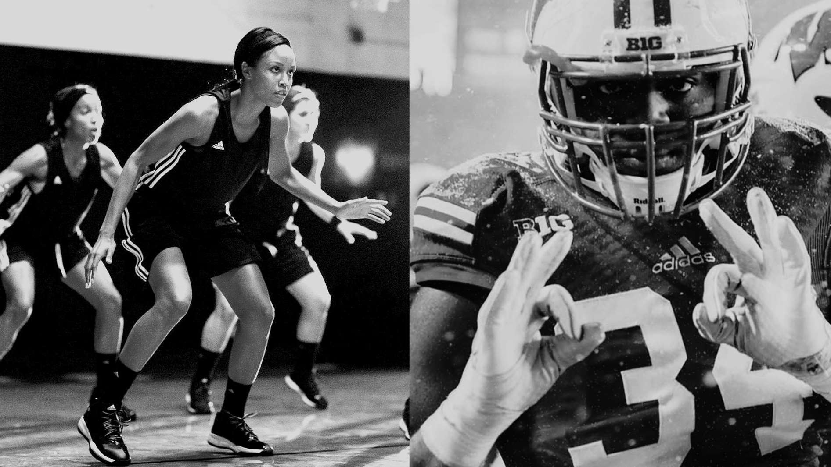



OUR MISSION
ADIDAS MOTHER BRAND
THE BEST
SPORTS BRAND
IN THE WORLD

Slide 5


ADIDAS MOTHER BRAND
5

Slide 6

ADIDAS MOTHER BRAND

Slide 7



ADIDAS BODY CARE
OUR VISION
OWN SPORTS
TERRITORY
OUR OBJECTIVE
THE #1 GLOBAL PERSONAL CARE BRAND
FOR SPORTS LOVERS

Slide 8





















ADIDAS & COTY
COTY LICENSING CONTRACT WITH ADIDAS
CONTRACT SIGNED IN 1984
OVER 30+ YEARS PARTNERSHIP
ADIDAS = ONE OF COTY’S BIGGEST BRANDS
STRONG
POWERFUL HERITAGE
+
8

Slide 9
ABOUT OUR BODY
9

Slide 10
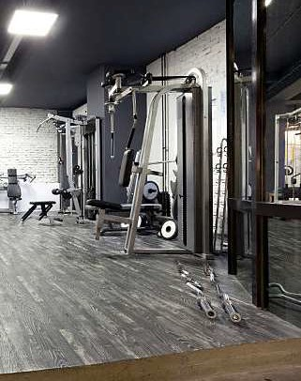


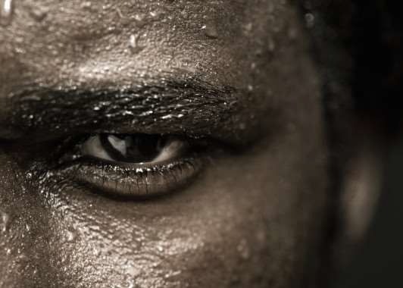
WHY DO WE SWEAT?
The role of sweat glands is to eliminate
heat in order to maintain constant body
temperature. So after going through the sweat pores, sweat evaporates, resulting in a decrease of body temperature
MAIN FUNCTION OF SWEAT IS TO CONTROL BODY TEMPERATURE
10

Slide 11

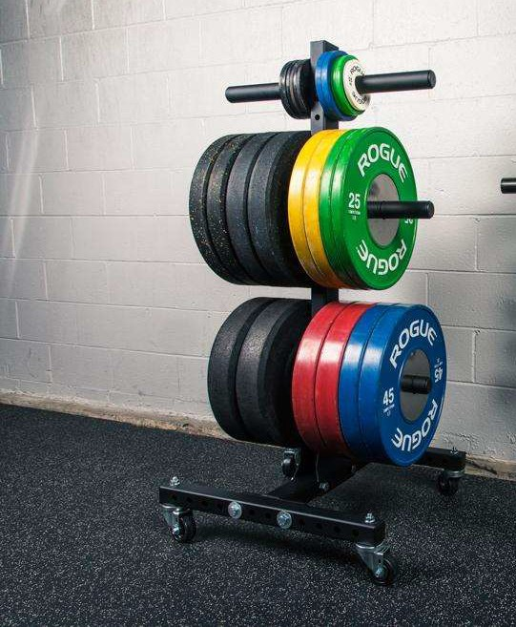
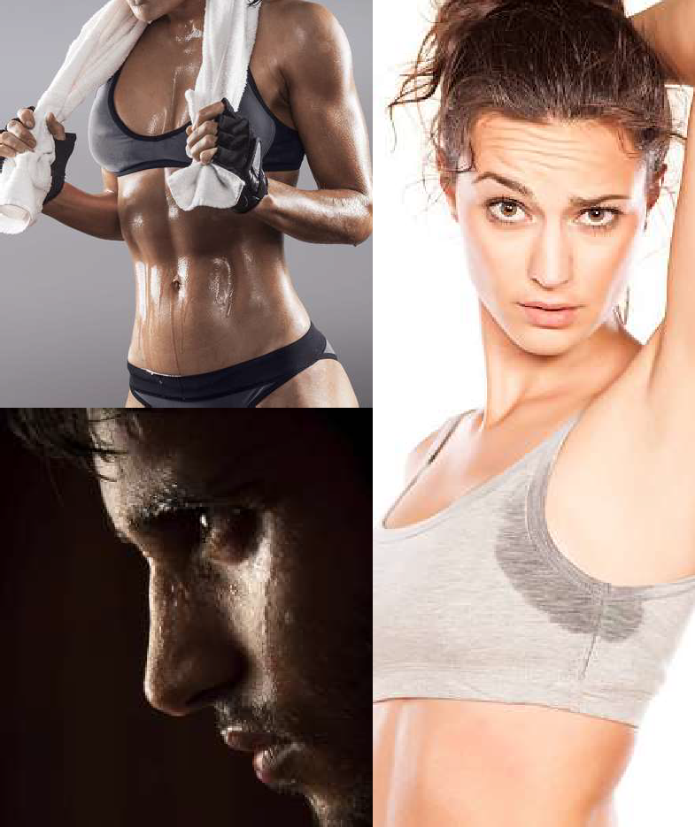
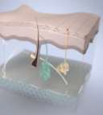
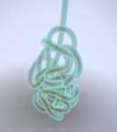
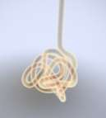
DID YOU KNOW?
Armpits exude the most odor in the
human body
Men have saltier sweat than women and sweat 40% more than women
THE AVERAGE PERSON HAS 2.6 MILLION SWEAT GLANDS IN THEIR BODY
ECCRINE SWEAT GLANDS
LOCATED ALL THROUGHOUT THE BODY
ODORLESS
APOCRINE SWEAT GLANDS
LOCATED IN ARMPITS & PUBIS
EXUDES ODOR
11

Slide 12

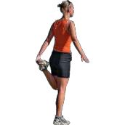

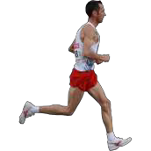




HOW DO WE MANAGE SWEAT?
WHAT CAN WE DO TO PROTECT OURSELVES FROM SWEAT?
12

Slide 13




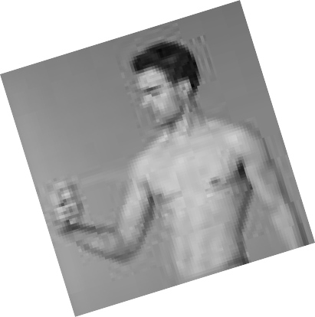

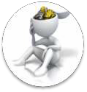







DIFFERENCE BETWEEN BODY SPRAY & ANTIPERSPIRANT
BODY SPRAYS
Fragrance, talc, anti bacteria, alcohol No aluminum salts
APD
Fragrance, talc, anti bacteria, alcohol,
aluminum salts
Prevents sweat and wetness sensation thanks to the astringent
Action of the aluminum salts.
Very efficient on sweat and wetness
sensation underarms; prevent odors
MAIN INGREDIENT
ACTION
Covers odors, perfumes
EFFICIENCY
Perfumes body and covers odor but does not prevent wetness sensation
Can be applied all over the body after shower
APPLICATION
Localized application to the “sweating
areas” , mainly underarms
13

Slide 14
ADIDAS ASSORTMENT
14

Slide 15






ADIDAS OPERATES IN 3 CATEGORIES
DEODORANTS
AFT^{EDT +} AVE
ER SH
SHOWER GELS
& MALE _{E}
FEMAL

Slide 16































DEODORANTS FOR MEN
WILL BE DISCONTINUED SOON
The deodorants portfolio compromises of 2 formats;
FRAGRANCE DEO
1.
2.
Sprays (150ml) Roll Ons (50ml)
Within sprays we have 2 segments;
Ice
Dive
Pure
Game
Dynamic Pulse
Victory
League
Team Force
Extreme Power
Team Five
Get Ready!
Fragrance Deodorants (including UEFA collection)
Antiperspirants
UEFA (FRAGRANCE DEO)
Star Edition
Arena Edition
Champions
Edition
Climacool | Adipower | Fresh | 6in1 | Sport Energy | Cool & Dry Intensive
ANTIPERSPIRANTS
16

Slide 17



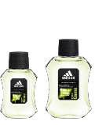

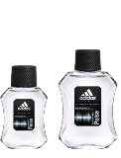




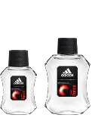










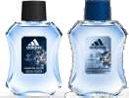
EAU DE TOILETTE & AFTER SHAVE FOR MEN
The EDT & After Shave portfolio compromises of the below;
EDT 100ml
EDT 50ml
AS 100ml
FRAGRANCE DEO FAMILY
This portfolio is part of the fragrance deo family. The APD range doesn’t have EDTs or AS
Ice Dive
Pure Game
Dynamic Pulse
Victory League
WILL BE DISCONTINUED SOON
Team Force
Extreme Power
Team Five
Get Ready!
WILL BE DISCONTINUED SOON
Arena Edition
UEFA RANGE
Star Edition
Champions Edition
17

Slide 18






















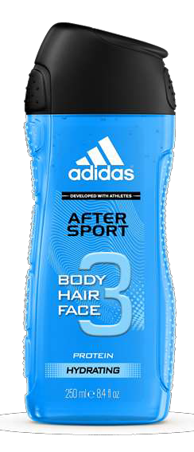
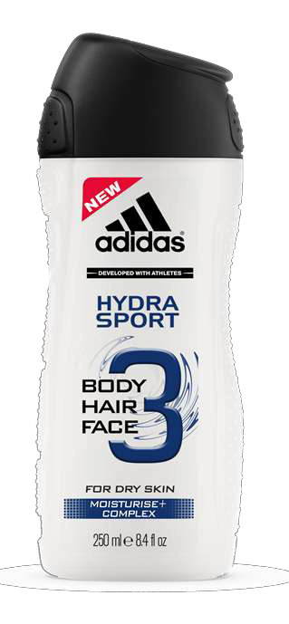
SHOWER GELS FOR MEN
FRAGRANCE FAMILY SHOWER GELS
Pure Game
Sport Energy
Arena Edition
After Sport ₁₈
Team Five
Get Ready!
The Shower Gel portfolio for men consists of 2 sizes;
- 250ml
- 400ml
The Showergels are splits as per the below;
Ice Dive
Dynamic Pulse
ANTIPERSPIRANT FAMILY SHOWER GELS
Fragrance Family Shower gels
Antiperspirant Family Shower gels
UEFA Shower Gels
Standalone Shower gels
Climacool
Adipower
UEFA SHOWER GELS
WILL BE DISCONTINUED SOON
Star Edition
Champions Edition
STANDALONE SHOWER GELS
Active Sport
Hydra Sport

Slide 19


















DEODORANTS FOR WOMEN
The deodorants portfolio compromises of 2 formats;
Natural Vitality
Pure Lightness
Floral Dream
1.
2.
Sprays (150ml) Roll Ons (50ml)
FRAGRANCE DEO
Within sprays we have 2 segments;
Fragrance Deodorants
Antiperspirants
Fruity
Rhythm
Fun Sensation
Get Ready!
6in1
Control
ANTIPERSPIRANTS
Climacool
Adipower
Fresh
19

Slide 20








EAU DE TOILETTE FOR WOMEN
The EDT portfolio compromises of the below;
- EDT 50ml
Fruity Rhythm
Fun Sensation
Natural Vitality
Pure
Lightness
Floral
Dream
Get Ready!
FRAGRANCE DEO FAMILY
This portfolio is part of the fragrance deo family. The APD range doesn’t have EDTs
20

Slide 21

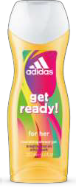






SHOWER GELS FOR WOMEN
Get Ready!
The Shower Gel portfolio for men consists of 2 sizes;
- 250ml
- 400ml (Only one SKU)
FRAGRANCE FAMILY SHOWER GELS
The Showergels are splits as per the below;
Fragrance Family Shower gels
Antiperspirant Family Shower gels
Standalone Shower gels
ANTIPERSPIRANT FAMILY SHOWER GELS
Climacool
Adipower
STANDALONE SHOWER GELS
Smooth
Vitality
Skin Detox
21

Slide 22
ABOUT ADIDAS BRAND ARCHITECTURE
22

Slide 23





ADIDAS RANGE ARCHITECTURE
MALE RANGE
FEMALE RANGE
1
2
3
1
2
FRAGRANCE
RANGE
FRAGRANCE
RANGE
UEFA
RANGE
ANTIPERSPIRANT
RANGE
ANTIPERSPIRANT
RANGE
Notes:
Male: UEFA is part of the Fragrance Range
There are standalone shower gels that do not belong to any specific range
23

Slide 24

ABOUT ADIDAS BRAND ARCHITECTURE
MALE FRAGRANCE LINE UEFA RANGE
24

Slide 25




UEFA CHAMPIONS LEAGUE
ADIDAS & UEFA HAVE A
LONG-TERM PARTNERSHIP
ADIDAS RELEASES A LIMITED
EDITION EVERY YEAR
UEFA CHAMPIONS LEAGUE IS THE
2ND HIGHEST FOLLOWED
FOOTBALL LEAGUE IN THE WORLD
25

Slide 26

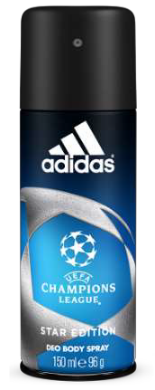

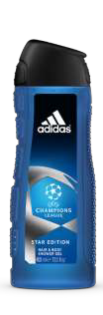
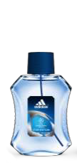
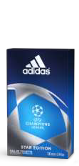
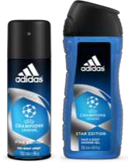

STAR EDITION (UEFA 2)
6
Inspired by
SPORT
ABOUT:
Inspired by the celebration of exceptional sporting achievement, surpass yourself and reach the stars.
THELINE-UP
THE SCENT:
An energizing and vibrant woody
green scent
Part of
UEFA
Vibrant
Clean
Comfortable
Long lasting
VIBRANT
scent
top note
cardamom seed
heart note
BS 150ml | Roll On 50ml | Shower Gel 250ml | Shower Gel 400ml | EDT 50ml | EDT 100ml | After Shave 100ml
✓ |  | ✓ | ✓ |  | ✓
lavender
base note
cedarwood
2

Slide 27

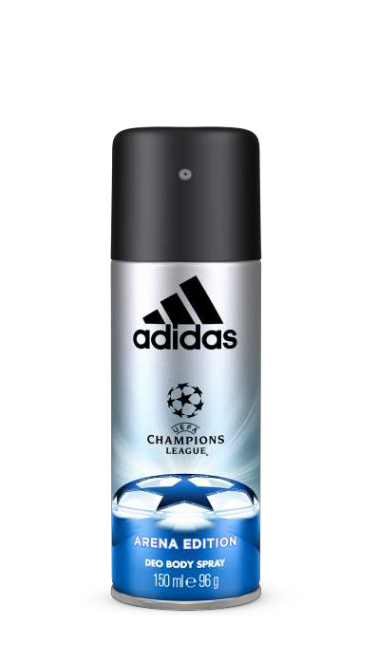

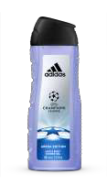
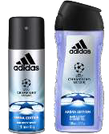
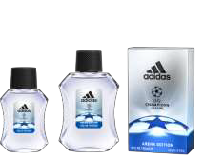
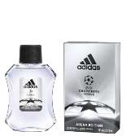

ARENA EDITION (UEFA 3)
7
Inspired by
SPORT
ABOUT:
Inspired by the adrenaline of entering in the arena and pushing your limits.
THELINE-UP
THE SCENT:
An explosive and powerful
oriental scent
Part of
UEFA
Refreshing
Energizing
Sensual
Long lasting
ORIENTAL
scent
top note
rosemary
heart note
BS 150ml | Roll On 50ml | Shower Gel 250ml | Shower Gel 400ml | EDT 50ml | EDT 100ml | After Shave 100ml
✓ |  | ✓ | ✓ | ✓ | ✓ | ✓
geranium
base note
patchouli
2

Slide 28

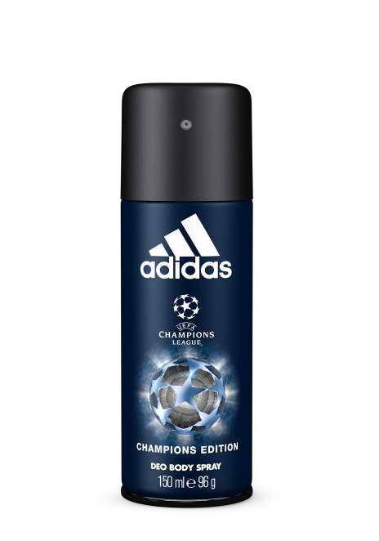

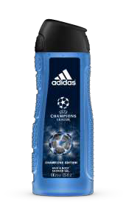
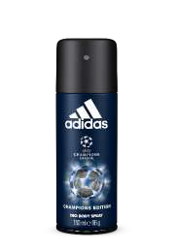
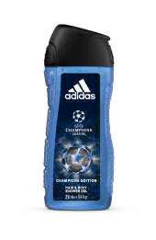
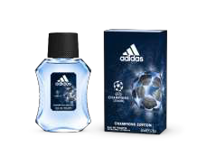
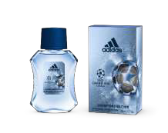




CHAMPIONS EDITION (UEFA 4)
8
Inspired by
SPORT
ABOUT:
Inspired by the elite players of the champions league.
THELINE-UP
THE SCENT:
An energizing and musky green
scent
Part of
UEFA
Citrus
Floral
Woody
Long lasting
MUSKY
scent
top note
lemon and lavender
heart note
clary sage
BS 150ml | Roll On 50ml | Shower Gel 250ml | Shower Gel 400ml | EDT 50ml | EDT 100ml | After Shave 100ml
✓ |  | ✓ | ✓ | ✓ | ✓ | ✓
base note
vanilla
2

Slide 29
ABOUT ADIDAS BRAND ARCHITECTURE
MALE FRAGRANCE LINE
29

Slide 30


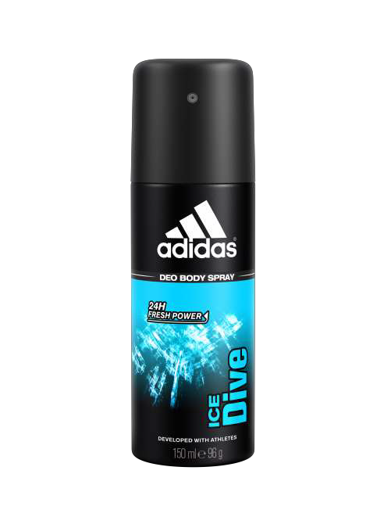

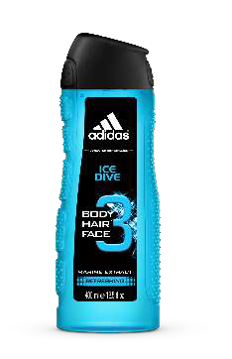
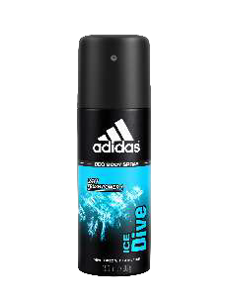
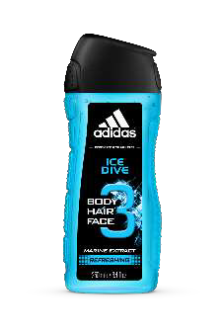
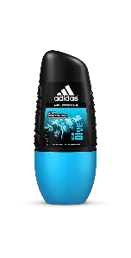
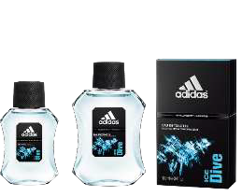
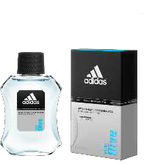

0
ICE DIVE
BEST
SELLER
ABOUT:
Inspired by the strength and the freshness of the ocean, explore new territories, share intense emotions.
THELINE-UP
THE SCENT:
A woody aromatic fragrance
Intense
ENERGY
Intense freshness
Energizing
Vibrant
Long lasting
FRESH
scent
top note
mint leaves
heart note
geranium
Body Spray 150ml | Roll On 50ml | Shower Gel 250ml | Shower Gel 400ml | EDT 50ml | EDT 100ml | After Shave 100ml
✓ | ✓ | ✓ | ✓ | ✓ | ✓ | ✓
base note
musk
3

Slide 31

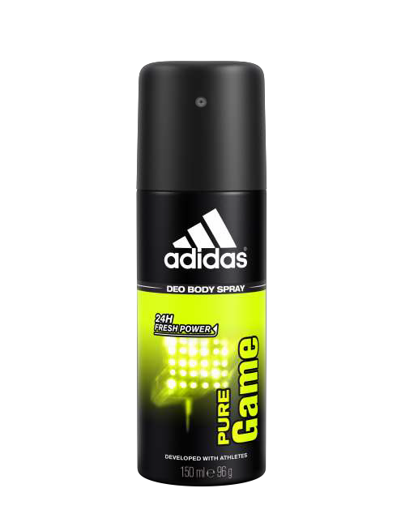

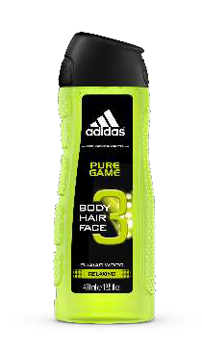
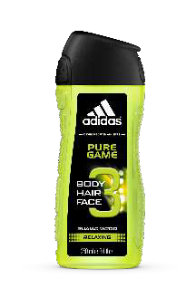
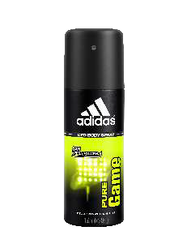
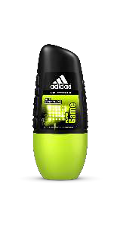
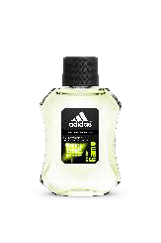

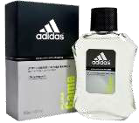

1
PURE GAME
CONFIDENCE
ABOUT:
Inspired by men who live their life to the fullest with confidence, on and off the pitch.
THELINE-UP
THE SCENT:
Woody aromatic fragrance
Fragrance that is
ADDICTIVE
Fusing
Elegant
Addictive
Long lasting
WOODY
scent
top note
pepper
heart note
cypress
Body Spray
150ml
Roll On
50ml
Shower Gel
250ml
Shower Gel
400ml
EDT
50ml
EDT
100ml
After Shave
100ml
✓
✓
✓
✓
✓
✓
✓
base note
patchouli
3

Slide 32

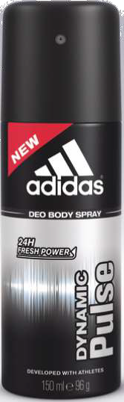







2
DYNAMIC PULSE
Inspired by intense
SPORT
ABOUT:
Inspired by intense sport sessions, the heat that invades your body, the pounding surge of your heart.
THELINE-UP
THE SCENT:
A clean aromatic fragrance
Fragrance that is
AROMATIC
Fresh
Refined
Contemporary
Long lasting
FRESH
scent
top note
ozonic accord
heart note
thyme
Body Spray 150ml | Roll On 50ml | Shower Gel 250ml | Shower Gel 400ml | EDT 50ml | EDT 100ml | After Shave 100ml
✓ | ✓ | ✓ | ✓ | ✓ | ✓ | ✓
base note
musk
3

Slide 33







3
VICTORY LEAGUE
Inspired by power of the
TEAM
ABOUT:
Inspired by the power of the team, because together we are strong and together we can achieve victory.
THELINE-UP
THE SCENT:
A woody oriental fragrance
Fragrance that is
WARM
Sparkling
Warm
Addictive
Long lasting
ORIENTAL
scent
top note
bergamot
heart note
cinnamon
base note
cedarwood vanilla
Body Spray 150ml | Roll On 50ml | Shower Gel 250ml | Shower Gel 400ml | EDT 50ml | EDT 100ml | After Shave 100ml
✓ |  |  |  |  | ✓ | ✓
3

Slide 34







4
TEAM FORCE
Inspired by strength of the
TEAM
ABOUT:
Inspired by the strength of the team, the pleasure of playing together.
THELINE-UP
THE SCENT:
An aromatic woody fragrance
Fragrance that is
SPARKLING
Sparkling
Elegant
Unexpected
Long lasting
WOODY
scent
top note
grapefruit
heart note
green pear
Body Spray 150ml | Roll On 50ml | Shower Gel 250ml | Shower Gel 400ml | EDT 50ml | EDT 100ml | After Shave 100ml
✓ |  |  |  |  | ✓ | ✓
base note
rich woods
3

Slide 35







5
EXTREME POWER
Intense
EXCITEMENT
ABOUT:
Inspired by the intense excitement of playing a match, the roar of the crowd.
THELINE-UP
THE SCENT:
An aromatic oriental fragrance
Fragrance that is
POWERFUL
Bright
Powerful
Enveloping
Long lasting
ORIENTAL
scent
top note
bergamot
heart note
coffee accord
Body Spray 150ml | Roll On 50ml | Shower Gel 250ml | Shower Gel 400ml | EDT 50ml | EDT 100ml | After Shave 100ml
✓ | ✓ |  |  |  | ✓
base note
tonka bean
3

Slide 36





TEAM FIVE
6
INSPIRED BY
FOOTBALL
ABOUT:
Inspired by freestyle football, the love of competition and the pleasure of creating our own rules.
THELINE-UP
THE SCENT:
A woody aromatic fragrance
SPARKLING
Sparkling
Addictive
Lively
Long lasting
WOODY
scent
top note
lemon
heart note
Body Spray 150ml | Roll On 50ml | Shower Gel 250ml | Shower Gel 400ml | EDT 50ml | EDT 100ml | After Shave 100ml
✓ |  | ✓ |  |  | ✓
clary sage
base note
mbery woods
3

Slide 37







GET READY
7
INSPIRED BY
FOOTBALL
ABOUT:
Inspired by the brazilian way of life, the maracanã stadium in rio, the thrills of a nation, feel the crowd’s energy.
THE SCENT:
THELINE-UP
An aromatic woody fragrance
FRESH &
SENSUAL
Colorful
Fresh
Sensual
Long lasting
WOODY
scent
top note
sea wave accord
heart note
tropical fruits and lavander
base note
sensual woods
Body Spray 150ml | Roll On 50ml | Shower Gel 250ml | Shower Gel 400ml | EDT 50ml | EDT 100ml | After Shave 100ml
✓ | ✓ | ✓ |  |  | ✓ | ✓
3

Slide 38

ABOUT ADIDAS BRAND ARCHITECTURE
FEMALE FRAGRANCE LINE
38

Slide 39





9
FRUITY RHYTHM
Inspired by
TRENDY
ABOUT:
Inspired by trendy women, full of energy, who live their life at high speed.
women
THELINE-UP
THE SCENT:
A fruity floral fragrance
Intense
ENERGY
Energetic
Radiant
Sensual
Long lasting
FRUITY
scent
top note
raspberry
heart note
cyclamen
base note
sandalwood
Body Spray 150ml | Roll On 50ml | Shower Gel 250ml | Shower Gel 400ml | EDT 50ml | EDT 100ml | After Shave 100ml
✓ |  |  |  | ✓
3

Slide 40






0
FUN SENSATION
JOYFUL
VIBES
ABOUT:
Inspired by young women searching for optimism and joyful vibes who enjoy optimism and cheerfulness
THELINE-UP
THE SCENT:
A fruity floral fragrance
ZESTY
Refreshing
Zesty
Delicate
Long lasting
FRUITY
scent
top note
raspberry
Body Spray 150ml | Roll On 50ml | Shower Gel 250ml | Shower Gel 400ml | EDT 50ml | EDT 100ml | After Shave 100ml
✓ |  |  |  | ✓
heart note
rose
4

Slide 41





1
NATURAL VITALITY
Inspired by
PASSIONATE
women
ABOUT:
Inspired by women full of energy and passionate by sport.
THELINE-UP
THE SCENT:
A floral watery fragrance
Intense
SPORT
Dynamic
Vibrant
Delicate
Long lasting
FLORAL
scent
top note
watermelon
heart note
lotus
Body Spray 150ml | Roll On 50ml | Shower Gel 250ml | Shower Gel 400ml | EDT 50ml | EDT 100ml | After Shave 100ml
✓ |  |  |  | ✓
base note
smooth musk
4

Slide 42






2
PURE LIGHTNESS
SOFT &
REFINED
ABOUT:
Inspired by women with a special attitude, who enjoy life and who feel
THELINE-UP
THE SCENT:
A fresh floral fragrance
FLORAL
Refreshing
Refined
Soft
Long lasting
FRESH
scent
top note
watery accords
heart note
magnolia
Body Spray 150ml | Roll On 50ml | Shower Gel 250ml | Shower Gel 400ml | EDT 50ml | EDT 100ml | After Shave 100ml
✓ |  |  |  | ✓
base note
musk
4

Slide 43






FLORAL DREAM
3
Inspired by
ELEGANT
ABOUT:
Inspired by elegant women who want to feel close to the nature and stay
fun.
THE SCENT:
women
THELINE-UP
A floriental fragrance
ELEGANCE
Elegant
Sensual
Addictive
Long lasting
FLORAL
scent
top note
bergamot
heart note
rose
Body Spray 150ml | Roll On 50ml | Shower Gel 250ml | Shower Gel 400ml | EDT 50ml | EDT 100ml | After Shave 100ml
✓ |  |  |  | ✓
base note
vanilla
4

Slide 44






GET READY
4
Inspired by
BRAZILIAN
ABOUT:
Inspired by the brazilian way of life, women natural beauty combined with effortless
at the fun.
women
THELINE-UP
THE SCENT:
A fruity floral fragrance
FRUITY FLORAL
Colourful
Joyful
Enveloping
Long lasting
FLORAL
scent
top note
grenadine fizz
heart note
water lily
Body Spray 150ml | Roll On 50ml | Shower Gel 250ml | Shower Gel 400ml | EDT 50ml | EDT 100ml | After Shave 100ml
✓ | ✓ | ✓ |  | ✓
base note
amber
4

Slide 45

ABOUT ADIDAS BRAND ARCHITECTURE
ANTIPERSPIRANTS
MALE & FEMALE LINE
45

Slide 46











PRIORITY
APD
6
CLIMACOOL
ABOUT:
Antiperspirant range giving you;
48 hour anti-perspirant protection (wetness & odor control)
Skin is kept fresh & dry all day long
48 HOUR
protection
THE SCENT:
THELINE-UP
Free Oil– fresh balance fragrance with clean signal
Capsules – encapsulated citrus & menthol fragrance with fresh signal
PERFORMANCE IN MOTION TECHNOLOGY
GENDER | APD 150ml | Roll On 50ml | Shower Gel 250ml | Shower Gel 400ml
MALE | ✓ | ✓ | ✓ | ✓
FEMALE | ✓ | ✓ | ✓
4

Slide 47








CLIMACOOL: PERFORMANCE IN MOTION TECHNOLOGY
47
THETECHNOLOGY
FRANCHISE BUILDING
TRANSFER OF PERFORMANCE TECHNOLOGY
THE HARDER
YOU GO, THE
BETTER IT WORKS
SKIN IS KEPT
FROM SPORTS APPAREL
FRESH & DRY
TO BODY CARE
ALL DAY LONG

Slide 48














ADIPOWER
8
EXTREME PROTECTION
ABOUT:
Antiperspirant range giving you;
72 hour anti-perspirant protection
Unique smart defense body response technology
Does not contain aluminium salts
THELINE-UP
72 HOUR
protection
THE SCENT:
Energizing & high performance fragrance for long lasting freshness & odor protection
BODY RESPONSE TECHNOLOGY
GENDER
APD
150ml
Roll On 50ml
Shower Gel 250ml
Shower Gel 400ml
airy & clean
fruity
mint
sandalwood
MALE
✓
✓
✓
✓
4
FEMALE
✓
✓
✓
✓

Slide 49










ADIPOWER: SMART BODY RESPONSE TECHNOLOGY
49
THETECHNOLOGY
activated by effort or movement
FRANCHISE BUILDING
closed capsules
capsules break to release the fresh
fragrance
throughout the day
long lasting freshness
TRANSFER POWER & RESPONSIVE TECHNOLOGY
PROVIDES
MAXIMUM
PROTECTION
WHEN YOU NEED IT THE MOST
SKIN IS KEPT
FRESH & DRY
ALL DAY LONG
FROM SPORTS APPAREL
TO BODY CARE

Slide 50








0% ALCOHOL
0
FRESH
ABOUT:
Antiperspirant range giving you;
48 hour anti-perspirant protection (wetness & odor control)
Refreshes you for the whole day
48 HOUR
protection
THE SCENT:
FRESH fragrance
ANTI-WHITE MARKS
THELINE-UP
GENDER | APD 150ml | Roll On 50ml | Shower Gel 250ml | Shower Gel 400ml
MALE | ✓ | ✓
FEMALE | ✓ | ✓
5

Slide 51







6 BENEFITS
IN 1 DEO
1
6 IN 1
THELINE-UP
ABOUT:
6 BENEFITS:
48
HOUR
ANTI – Odor
ANTI wetness
ANTI bacterial
EXTRA freshness
ANTI white marks
ANTI yellow stains
ANTI-WHITE MARKS
GENDER | APD 150ml | Roll On 50ml | Shower Gel 250ml | Shower Gel 400ml
MALE | ✓ | ✓
FEMALE | ✓ | ✓
5

Slide 52






72 HOUR
PROTECTION
2
SPORT ENERGY
ABOUT:
Antiperspirant range giving you;
Intensive 72 hour protection
Protects skin complextion
Anti-white marks
THELINE-UP
Keeps you
COOL &
DRY
THE SCENT:
Showergel contains lime extract for recharging effect
ANTI WHITE MARKS
GENDER | APD 150ml | Roll On 50ml | Shower Gel 250ml | Shower Gel 400ml
MALE | ✓ | ✓ | ✓
FEMALE
5

Slide 53




72 HOUR
PROTECTION
3
COOL & DRY INTENSIVE
ABOUT:
Antiperspirant roll on giving you;
Intensive 72 hour protection
Keeps you cool & dry
THELINE-UP
Keeps you
COOL &
DRY
GENDER | APD 150ml | Roll On 50ml | Shower Gel 250ml | Shower Gel 400ml
MALE |  | ✓
FEMALE
5

Slide 54





CONTROL
4
48 HOUR
PROTECTION
ABOUT:
Antiperspirant range giving you;
Intensive 48 hour protection
Cool & cares for skin
0% alcohol – pH respects the skin
Dermatologically tested
THELINE-UP
COOL & CARES
FOR YOUR SKIN
GENDER | APD 150ml | Roll On 50ml | Shower Gel 250ml | Shower Gel 400ml
MALE
FEMALE | ✓ | ✓
5

Slide 55
ABOUT ADIDAS BRAND ARCHITECTURE
STANDALONE SHOWER GELS
MALE & FEMALE SHOWER GELS
55

Slide 56



MALE STANDALONE SHOWER GELS
REVITALIZING
HYDRATING
MOISTURIZING
Contains Pro Vitamin B5
Contains Pro5t6ein
For Dry Skin Improves complexion

Slide 57





FEMALE STANDALONE SHOWER GELS
ENERGIZING
DETOXIFYING
EXFOLIATING
Hydrating massage pearls
Acai exfoliating beads
Hydrating micro pearls
57

Slide 58

ABOUT ADIDAS BRAND ARCHITECTURE
SUMMARY OF TOTAL PORTFOLIO
58

Slide 59















ANTIPERSPIRANTS MALE
CLIMACOOL MALE
6 IN 1 MALE
COOL & DRY INTENSIVE
APD 150ml | Roll On 50ml | Shower Gel 250ml | Shower Gel 400ml | EDT 50ml | EDT 100ml | After Shave 100ml
✓ | ✓ | ✓ | ✓
APD 150ml | Roll On 50ml | Shower Gel 250ml | Shower Gel 400ml | EDT 50ml | EDT 100ml | After Shave 100ml
✓ | ✓
APD 150ml | Roll On 50ml | Shower Gel 250ml | Shower Gel 400ml | EDT 50ml | EDT 100ml | After Shave 100ml
 | ✓
SPORT ENERGY
ADIPOWER MALE
FRESH MALE
APD 150ml | Roll On 50ml | Shower Gel 250ml | Shower Gel 400ml | EDT 50ml | EDT 100ml | After Shave 100ml
✓ | ✓ | ✓
APD 150ml | Roll On 50ml | Shower Gel 250ml | Shower Gel 400ml | EDT 50ml | EDT 100ml | After Shave 100ml
✓ | ✓ | ✓ | ✓
APD 150ml | Roll On 50ml | Shower Gel 250ml | Shower Gel 400ml | EDT 50ml | EDT 100ml | After Shave 100ml
✓ | ✓
59

Slide 60






































FRAGRANCE LINEUP – MALE
ICE DIVE |  |  |  |  |  |  | PURE GAME |  |  |  |  |  |  | DYNAMIC PULSE |  |  |  |  |  |  | TEAM FIVE
BS 150ml | Roll On 50ml | SG 250ml | SG 400ml | EDT 50ml | EDT 100ml | AS 100ml | BS 150ml | Roll On 50ml | SG 250ml | SG 400ml | EDT 50ml | EDT 100ml | AS 100ml | BS 150ml | Roll On 50ml | SG 250ml | SG 400ml | EDT 50ml | EDT 100ml | AS 100ml | BS 150ml | Roll On 50ml | SG 250ml | SG 400ml | EDT 50ml | EDT 100ml | AS 100ml
✓ | ✓ | ✓ | ✓ | ✓ | ✓ | ✓ | ✓ | ✓ | ✓ | ✓ | ✓ | ✓ | ✓ | ✓ | ✓ | ✓ | ✓ | ✓ | ✓ | ✓ | ✓ |  | ✓ |  |  | ✓
VICTORY LEAGUE
TEAM FORCE
EXTREME POWER
GET READY MALE
WILL BE DISCONTINUED SOON
BS
150ml
Roll On 50ml
SG
250ml
SG
400ml
EDT
50ml
EDT
100ml
AS
100ml
BS
150ml
Roll On 50ml
SG
250ml
SG
400ml
EDT
50ml
EDT
100ml
AS
100ml
BS
150ml
Roll On 50ml
SG
250ml
SG
400ml
EDT
50ml
EDT
100ml
AS
100ml
BS
150ml
Roll On 50ml
SG
250ml
SG
400ml
EDT
50ml
EDT
100ml
AS
100ml
✓
✓
✓
✓
✓
✓
✓
✓
✓
✓
✓
✓
✓
✓
✓
✓
60

Slide 61












FRAGRANCE LINEUP – UEFA – MALE
UEFA 2 STAR EDITION
UEFA 3 ARENA EDITION
UEFA 4 CHAMPIONS EDITION
BS 150ml | Roll On 50ml | Shower Gel 250ml | Shower Gel 400ml | EDT 50ml | EDT 100ml | After Shave 100ml
✓ |  | ✓ | ✓ |  | ✓
BS 150ml | Roll On 50ml | Shower Gel 250ml | Shower Gel 400ml | EDT 50ml | EDT 100ml | After Shave 100ml
✓ |  | ✓ | ✓ |  | ✓ | ✓
BS 150ml | Roll On 50ml | Shower Gel 250ml | Shower Gel 400ml | EDT 50ml | EDT 100ml | After Shave 100ml
✓ |  | ✓ | ✓ | ✓ | ✓ | ✓
61

Slide 62









ANTIPERSPIRANTS – FEMALE
CLIMACOOL FEMALE
ADIPOWER FEMALE
FRESH FEMALE
APD 150ml | Roll On 50ml | Shower Gel 250ml | Shower Gel 400ml | EDT 50ml | EDT 100ml | After Shave 100ml
✓ | ✓ | ✓
APD 150ml | Roll On 50ml | Shower Gel 250ml | Shower Gel 400ml | EDT 50ml | EDT 100ml | After Shave 100ml
✓ | ✓ | ✓ | ✓
APD 150ml | Roll On 50ml | Shower Gel 250ml | Shower Gel 400ml | EDT 50ml | EDT 100ml | After Shave 100ml
✓ | ✓
CONTROL
6 IN 1 FEMALE
APD 150ml | Roll On 50ml | Shower Gel 250ml | Shower Gel 400ml | EDT 50ml | EDT 100ml | After Shave 100ml
✓ | ✓
APD 150ml | Roll On 50ml | Shower Gel 250ml | Shower Gel 400ml | EDT 50ml | EDT 100ml | After Shave 100ml
✓ | ✓
62

Slide 63














FRAGRANCE LINEUP – FEMALE
GET READY
FLORAL DREAM
FRUITY RHYTHM
BS 150ml | Roll On 50ml | Shower Gel 250ml | Shower Gel 400ml | EDT 50ml | EDT 100ml | After Shave 100ml
✓ | ✓ | ✓ |  | ✓
BS 150ml | Roll On 50ml | Shower Gel 250ml | Shower Gel 400ml | EDT 50ml | EDT 100ml | After Shave 100ml
✓ |  |  |  | ✓
BS 150ml | Roll On 50ml | Shower Gel 250ml | Shower Gel 400ml | EDT 50ml | EDT 100ml | After Shave 100ml
✓ |  |  |  | ✓
NATURAL VITALITY
PURE LIGHTNESS
FUN SENSATION
BS 150ml | Roll On 50ml | Shower Gel 250ml | Shower Gel 400ml | EDT 50ml | EDT 100ml | After Shave 100ml
✓ |  |  |  | ✓
BS 150ml | Roll On 50ml | Shower Gel 250ml | Shower Gel 400ml | EDT 50ml | EDT 100ml | After Shave 100ml
✓ |  |  |  | ✓
BS 150ml | Roll On 50ml | Shower Gel 250ml | Shower Gel 400ml | EDT 50ml | EDT 100ml | After Shave 100ml
✓ |  |  |  | ✓
63

Slide 64












SPORT PERFORMANCE SHOWERGELS (MALE & FEMALE)
(STAND ALONE SHOWER GELS, NOT PART OF A RANGE)
AFTER SPORT MALE ACTIVE START MALE
HYDRA SPORT MALE
BS 150ml | Roll On 50ml | Shower Gel 250ml | Shower Gel 400ml | EDT 50ml | EDT 100ml | After Shave 100ml
 |  | ✓
BS 150ml | Roll On 50ml | Shower Gel 250ml | Shower Gel 400ml | EDT 50ml | EDT 100ml | After Shave 100ml
 |  | ✓
BS 150ml | Roll On 50ml | Shower Gel 250ml | Shower Gel 400ml | EDT 50ml | EDT 100ml | After Shave 100ml
 |  | ✓
VITALITY FEMALE
SMOOTH FEMALE
SKIN DETOX FEMALE
BS 150ml | Roll On 50ml | Shower Gel 250ml | Shower Gel 400ml | EDT 50ml | EDT 100ml | After Shave 100ml
 |  | ✓
BS 150ml | Roll On 50ml | Shower Gel 250ml | Shower Gel 400ml | EDT 50ml | EDT 100ml | After Shave 100ml
 |  | ✓
BS 150ml | Roll On 50ml | Shower Gel 250ml | Shower Gel 400ml | EDT 50ml | EDT 100ml | After Shave 100ml
 |  | ✓
64

Slide 65
COMPETITION
65

Slide 66
















OUR COMPETITORS
AEROSOLS
EAU DE TOILETTE
SHOWER GELS
WE ARE LEADERS
66

Slide 67


WHO DO WE WANT TO BEAT?
WHY?
Rexona has a technology called motionsense
Vs.
Adidas Climacool has a technology called Performance In Motion
Rexona communicates
SPORTS & PERFORMANCE
Vs.
Adidas as a global brand owns SPORTS
67

Slide 68
TARGET AUDIENCE
68

Slide 69




TOMORROW‘S CONSUMER BASE
+
SPORTY TEENS
SPORTY TEENS +YOUNG URBANITES
20 +- 35 year old, Male & Female, urban, active lifestyle
Juggle between work, family, friends, hobbies
Occasional sport practice to stay healthy and fit
Watch sports with friends
Mix sport and fashion – trend adopter
Highly connected
14-20 year old, Male & Female, high school
Sport is important in their daily life
Brand oriented and interested in innovation
Sports stars are role models for them

Slide 70
SELLING APPROACH
70

Slide 71






SELLING APPROACH
CUSTOMER WELCOME
CREATING THE RELATIONSHIP
CONVINCING THECUSTOMER
“Climacool is one of our best antiperspirants which has a unique technology. Once you spray it on your body it releases capsules that are activated once you move. It will release a fresh scent once you sweat”
Hi, did you know that Adidas has a Body Care range?
“Climacool will give you 48 hours protection against wetness and odor”
CROSS & LINK SELLING
CLOSING THESALE
BE POSITIVE
LISTEN TO THE CLIENT’S CONCERN
MENTION THE ADVANTAGES OF THE BRAND
“Climacool is also available in roll on and shower gel providing the same technology”
“We also have Body Sprays with different types of fragrances”
“I am sure you will enjoy what you have selected”
“There is also a 2+1 promotion on the Climacool shower gel”

Slide 72



YOU ARE THE FACE OF THE BRAND
Always ensure you have minimal nude make-up
Keep your nails neat & clean – with light colors
Tie your hair to keep it neat
Always wear the recommended uniform and ensure it is neatly pressed and kept clean

Slide 73


DO‘S & DON‘TS
Knowledge of the brand is must
Try to understand shopper’s needs & then recommend relevant product from within the brand. If relevant product not available then recommend from other Coty Brands (Playboy)
Well groomed – clean uniform, hair neatly tied & covered, neat make up, clean nails, minimal accessories unless part of brand uniform
Always smiling & willing to help
Proactive – approaches shoppers on her own to promote the brand
Never look away from shoppers, maintain eye contact
Keep the brand team informed about out of stock, competitors & any
issues with consumers
Get familiar with the entire product line and the category of products that Adidas falls in
Get familiar with the Adidas selection in the store you are in
Get familiar with Adidas prices and current promotions in the store you
are in
Stay positive, friendly, and polite to every single potential customer
✗ Do not talk about the competition negatively – if customer asks about the difference, use the product knowledge
✗ Do not smoke wearing the uniform or brand badge. Always ensure smoke breaks are taken discretely
✗ You are the face of the brand – do not talk on the phone during work hours or on the retail aisle floor
✗ Do not socialize with other brand ambassadors, especially competitors. You can spend time with them outside of working hours not on the retail aisle
✗ The uniform must be worn in the way it has been advised,. Do not change anything on the designated uniform
✗ Social Network use – you are not allowed to share any business information, private events, training or competitor activity on social media
✗ Do not take any photos of Adidas or competitors on the retail aisle
without permission
✗ Do not take any photos of any consumers without consent

Slide 74

LET‘S STAY CONNECTED
AVAILABLE ANYTIME
Rita Harb
+971 564806830
We will create a WhatsApp group
You can ask questions
Share competitor updates
Concerns
Reporting

Slide 75
GOOD LUCK!!!
75

Slide 76

THANK YOU
REGIONAL MARKETING – MEA
CELINE FAY
Head of Marketing – Body Care & Mass Fragrances Celine_Fay@cotyinc.com
KARUNA RUPANI
Senior Brand Manager – Body Care Karuna_Rupani@cotyinc.com
RITA HARB
Junior Brand Manager – Body Care Rita_Harb@cotyinc.com

