Slide 2
Mr. Roman
Roman And Associates
Immigration Services Ltd
Registered Canadian Immigration Consultant
R524540

Slide 3
Founder’s Life Story
1978: Born in the Philippines
2003: Graduate of Bachelors Science in Nursing
2003: Worked as an operating room nurse in UERM
2004: Worked as a nursing professor
2007: Applied as a full time nurse anywhere in BC

Slide 4
Founder’s Employment Timeline in BC
2008: Started working as a front line nurse in Nanaimo Regional General Hospital, BC
2011: Clinical Coordinator for the Cardiology floor
2014: Temporary manager for ICU, Cardiology Floor, Electro Diagnostic Services, ECHO, Pacemaker

Slide 5
Founder’s Employment Timeline in BC
2015: Permanent manager for ICU, Cardiology Floor, Electro Diagnostic Services, ECHO, Pacemaker
Island Health's Heart Health
Nanaimo News Bulletin

Slide 6
My Self Employment – Recruitment Agency
Home is Best Caregiver Services
Homecare
Housekeeping
Home support

Slide 7
My Self Employment – Recruitment Agency
Home is Best Caregiver Services
Live-in caregivers
Hong Kong
Taiwan
Philippines
UAE

Slide 8
Registered Consultant
Licensed and Registered Canadian Immigration Consultant
R524540
ICRRC (Immigration Consultants of Canada Regulatory Council)

Slide 9
Pathway to Canada
Express Entry

Slide 10
Express Entry
Federal Skilled Worker Program
Federal Trades Worker Program
Canadian Experience Class
Express Entry

Slide 11
Express Entry Procedure

Slide 12
Comprehensive Ranking System
Candidates who meet FSW/FST/CEC will get selected into Pool of Candidates
Candidates will receive a score based on the Comprehensive Ranking System
Candidates with the highest ranking score and meets the cut off score gets the invitation to apply for Permanent Residence

Slide 13
Comprehensive Ranking System
690 pts
464 pts
500 pts
670 pts
Meets the minimum requirement
Highest qualified candidate

Slide 14
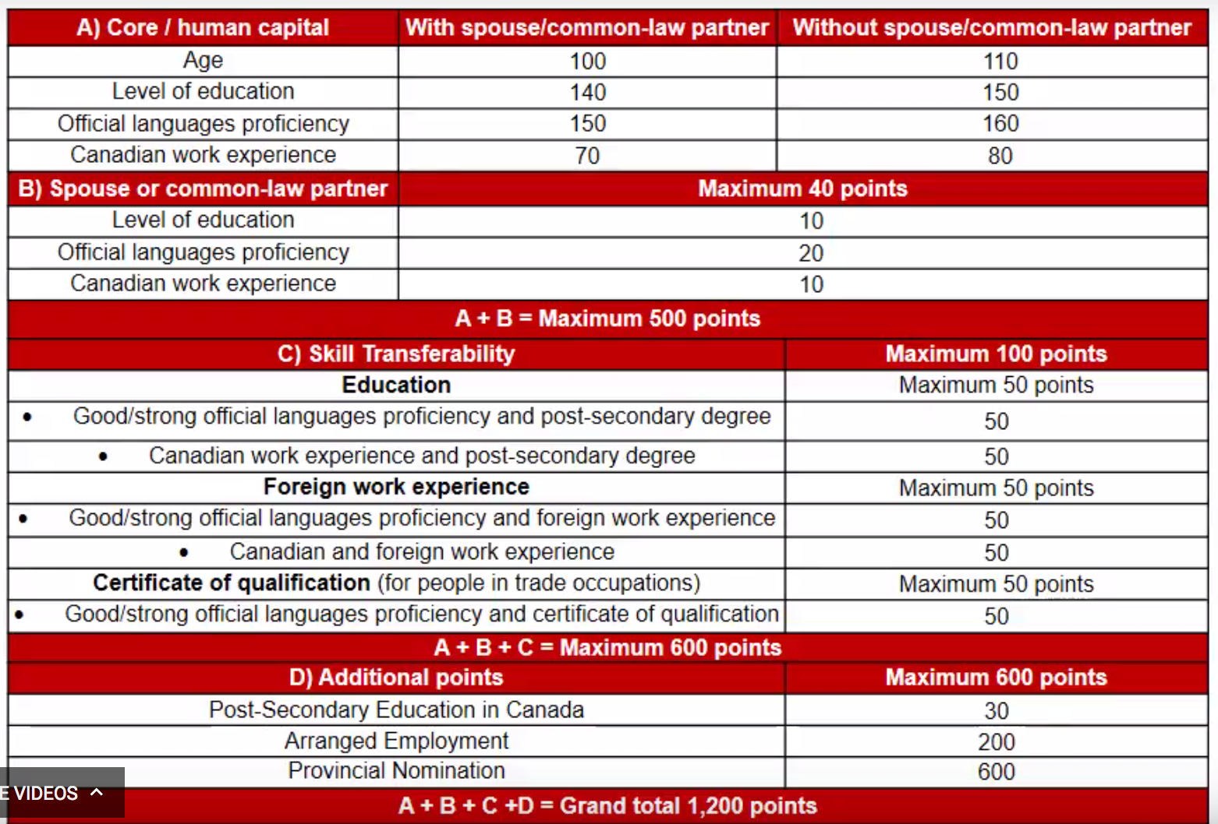

Slide 15
Express Entry
Federal Skilled Worker Program
Federal Trades Worker Program
Canadian Experience Class
Express Entry

Slide 16
Federal TRADES Worker Program
Minimum Requirement:
Work Experience
have at least two years of full-time work experience (or an equal amount of part-time work experience in a skilled trade within the five years before you apply,
industrial, electrical and construction trades,
maintenance and equipment operation trades,
supervisors and technical jobs in natural resources, agriculture and related production,
processing, manufacturing and utilities supervisors and central control operators,
Chefs, cooks, butchers and bakers.

Slide 17
Federal TRADES Worker Program
Minimum Requirement:
Language Ability
CLB 5 (English) for speaking and listening (IELTS 5.0 for both), and
CLB 4 (English) for reading and writing (IELTS 3.5 and 4.0 respectively).
Education:
No education requirement
have an offer of full-time employment for a total period of at least one year or a certificate of qualification in that skilled trade issued by a Canadian provincial or territorial authority

Slide 18
Express Entry
Federal Skilled Worker Program
Federal Trades Worker Program
Canadian Experience Class
Express Entry

Slide 19
Canadian Experience Class
Minimum Requirement:
Work Experience
1 year of PAID Canadian Experience
full-time (30 hours/week) or an equal amount in part-time (15 hours/week) = 1560 hours
paid work (volunteer work, unpaid internships do not count),
within the last 3 years, and at
skill type 0, A or B of the 2011 NOC

Slide 20
Canadian Experience Class
Minimum Requirement:
Language Ability
CLB 7 for NOC 0 and A (IELTS 6.0)
CLB 5 for NOC B (IELTS 5.0 but 4.0 for Reading)
Education:
No education requirement

Slide 21
Express Entry
Federal Skilled Worker Program
Federal Trades Worker Program
Canadian Experience Class
Express Entry

Slide 22
Federal SKILLED Worker Program
Minimum Requirement:
Work Experience
at least one year (1,560 hours total / 30 hours per week),
continuous full-time or an equal amount in part-time,
paid work (volunteer work, unpaid internships do not count),
In the same job,
within the last 10 years, and at
skill type 0, A or B of the 2011 NOC

Slide 23
Federal SKILLED Worker Program
Minimum Requirement:
Language Ability
Canadian Language Benchmark (CLB) 7 speaking and listening, reading and writing. (IELTS score of 6.0)
Education:
a Canadian secondary (high school) or post-secondary certificate, diploma or degree, OR
a completed foreign credential, and an Educational Credential Assessment (ECA) report from an agency approved by IRCC.

Slide 24
Federal SKILLED Worker Program
Minimum Requirement:
Gets 67 points out of 100 in the six selection factors
Language Ability,
Education,
Work experience
Age,
Valid job offer, and
Adaptability (how well you are likely to settle here)

Slide 25
Federal SKILLED Worker Program
Sample Scoring:
Factors | Situation | Score
Language Ability | IELTS CLB 8 (IELTS 6.5 but 7.5 on listening) | 20
Education | Masters Degree | 23
Work Experience | 6 Years or more | 15
Age | 18-35 | 12
Valid Job Offer | None | 0
Adaptability | With Spouse or relatives in Canada | 5
Total FSW Score |  | 77
Notes:
+10 for Adaptability is for at least one year of full-time work in Canada.

Slide 26
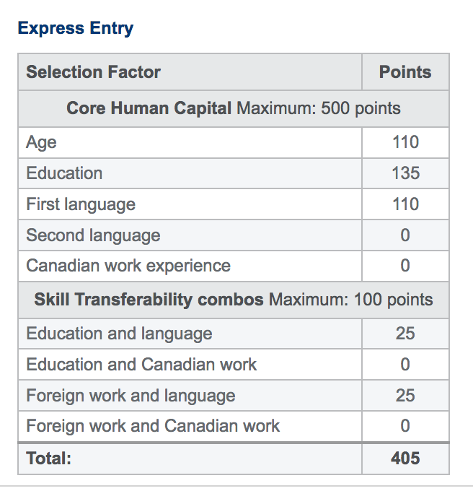
Federal SKILLED Worker Program
Sample Scoring:
Comprehensive Ranking Score
Lowest CRS Invited to apply for Permanent Residency: 415 points
Notes:
+10 for Adaptability is for at least one year of full-time work in Canada.

Slide 27
“Easiest” Pathway to Canada
STUDY PERMIT

Slide 28
“Easiest” Pathway to Canada

Slide 29
“Easiest” Pathway to Canada
Apply for Study Permit (8 month course or more)
After successfully passing the course, Apply for Post Graduate Work Permit
Apply for Permanent residency via Express Entry Program – Canadian Experience Class

Slide 30
Federal Requirements To Enter Canada Under Student Permit
All persons must be of the legal age of 18 years old.
Successfully pass verification of all criminal record, employment, study periods and background checks.
Be of good health and sound mind
Provide all documentation required truthfully, accurately, and within required time period given

Slide 31
Federal Requirements To Enter Canada Under Student Permit
Show proof of intended financial support
10-50% down payment school tuition fee = Acceptance Letter (depends on the institution)
Balance can be paid while in school.
Minimum amount needed
Tuition fee (first year) plus
$12k (no accompanying dependent)
*Down payment is paid directly to the school and refundable

Slide 32
Federal Requirements To Enter Canada Under Student Permit
Proof of student/education loan from a financial institution;
Bank statements for the past four months;
A letter from the person any relatives or friends or institution providing you with money
Learning plan

Slide 33
School Requirements
Course Assessment Form
Transcript of Record and Diploma/Certificate
Post-Secondary
College
Copy of Passport
IELTS Score (score needed varies from each school)
Meshkat Higher Education Institute

Slide 34
Student Benefits
Interest free payment plans will be available to you.
The school will assist in connecting you with multicultural helping house society’s temporary housing coordinator.
In some schools, regulated International Student Immigration Advisor (RISIA) or registered and licensed Canadian immigration consultants are available and employed by the school

Slide 35
Student Benefits
Your student visa will allow you to work legally any type of jobs available since it will also act as an open work visa. (20 hours/ week during school season and 40 hours/ week during off school)
You will be able to bring over to Canada your dependent e.g. spouse or common-law children.
Yes, you may bring your love one with you (If the immigration guidelines are met)

Slide 36
What’s Next After School
Work under the Post Graduate Work Permit then
Apply for Permanent Residency.
Minimum Wage:
Lowest: Newfoundland $10.50/hour
Highest: Nunavit $13.00/hour
Minimum wages across Canada in 2017

Slide 37
Funds Needed for Foreign Student
Student with NO dependent → Required at least $12,000 CAD
Student with ONE dependent → additional $4,000 CAD for show money.
Each additional family member → additional $3,000 CAD each for show money.
Average School Tuition per year → $12,000 – 16,000 CAD
NOTE: your dependents will be able to work unlimited hours….

Slide 38
Study Permit Process CAD $2,500
Initial Immigration Consultation Fee CAD $1000
Submission of all required docs for the School
Applicant is given choices of courses
Applicant chooses the course
Applicant submits additional docs (if applicable) plus school application fee
Pay required tuition fees (down payment)
Submission of documents for the Study Permit
Sign the
Retainer’s Agreement
Receive Official Letter of Acceptance
2nd Payment of $1000 Due
Apply For Study Permit
Last Payment of $500 Due
Come to Canada

Slide 39
Study Permit
Express Entry - Canadian Experience Class
Post Graduate Work Permit
Permanent Resident Status
Career Path

Slide 40
The End

