Slide 1
Pesticides and food safety
Supervisor : Dr Rahimfard
By : Melika Zandi

Slide 2
What is Pest?

Slide 3
Definitions?
IPM is pest management system based on sanitation,
maintenance, inspection and monitoring. Pesticides are applied only in response to insect pressure, as indicated by monitoring the pest population, and only if all cultural and mechanical methods ail.
No monitoring, no inspection, no IPM

Slide 4
IPM
* Natural Controls * Examples
* Climate * Adverse temperatures
* Natural Enemies * Lady beetles
* Geographic barriers * Stone Landscape
* Food & water * Dry leaves (Fungi)
* Shelter * Snakes (remove brush)

Slide 5
IPM
* Applied Controls * Examples
* Host plant resistance * resistant varieties
* Biological * Phorid flies
* cultural * Crop rotation
* Mechanical * Animal traps
* Sanitation * Remove infected foliage
* Legal * Quarantines, embargos
* Chemical * Pesticides

Slide 6
Practical IPM Methods

Slide 7
What is pesticide?
* A pesticide is any substance or mixture of substances intended for preventing, destroying, repelling, or mitigating any pest.
* “ Pesticide ” includes herbicides, fungicide, insecticides, or any other substance used to control pests.
* Pesticides are carefully regulated by the Environmental Protection Agency (EPA), which reviews studies to determine the risks posed by individual pesticides.

Slide 8
History of Pesticides

Slide 9
IPM
* Insecticide * Piscicide
* Herbicide * Nematicide
* Acaricide * Miticide
* Molluscicide * Repellant
* Rodenticide * Growth Regulator
* Fungicide * Bactericide

Slide 10
Pesticide Types by Pest

Slide 11
Pesticide Types by Pest

Slide 12
Pesticide Types by Pest

Slide 13
Pesticide Types by Pest

Slide 14
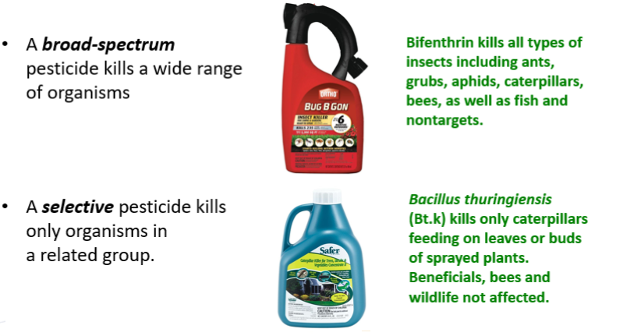
Pesticide Selectivity- can help protect the environment, people and nontarget plants

Slide 15
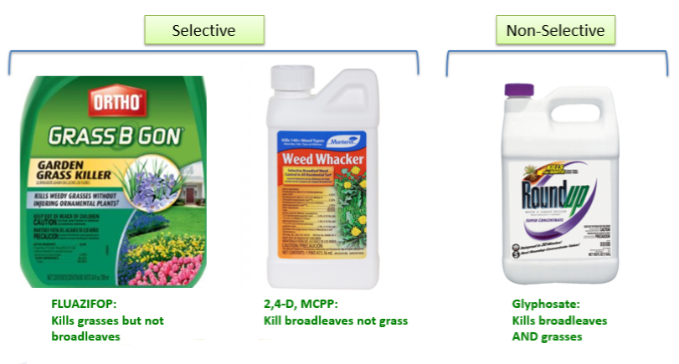
Pesticide Selectivity- Herbicides

Slide 16
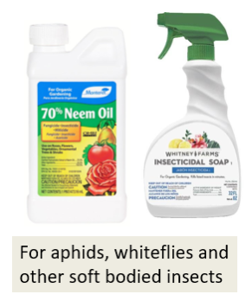
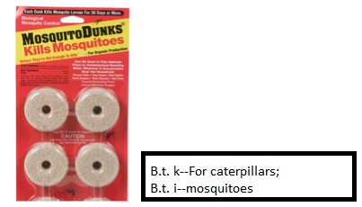
What are some organic and less toxic insecticides?
* Pesticidal soaps
* Certain petroleum oils
* Plant based oils such as neem and others
* Microbials such bacillus thurengiensis(Bt)

Slide 17
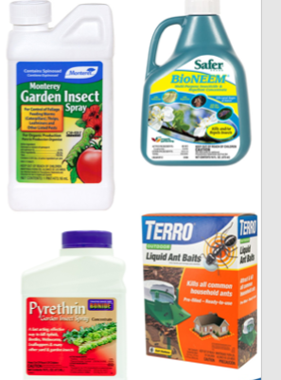
Other lower toxicity insectidies
* Spinosad- chewing insects and thrips.
A natural fermentation product.
* Botanical or plant-derived insecticides-
phrethrin/pyrethrum and azadirachtin
(neem extract)
* Boric acid or borate for ant control
* All these materials generally organically
acceptable, breakdown rapidly in the
environment and have less impact on
beneficials, people and wildlife than
conventional insecticides.

Slide 18
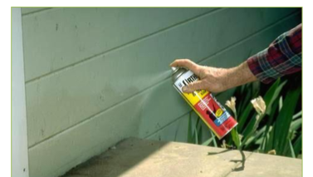
Common home use insecticide products Not qualifying ass less toxic
* Organophosphates
(malathion, acephate, disulfotion)
* Carbamates
(Carbaryl—Sevin)
* Pyrethriods
(bifenthrin, permethrin, cyfluthrin
cypermethrin, lambda-cyhalothrin)
* Neonictotinoids
(imidacloprid, dinotefuran, others)

Slide 19
Herbicides Used in Organic Systems
* Plant-based oils (clove,
eugenol, lemongrass, rosemary)
* Pelargonic acid
* Herbicidal soap
* 20% Vinegar/Acetic Acid
(weed pharm)
* These products are effective only on young plants, primarily broadleaves
* Not effective on perennials or plants with substantial roots
* Nonselective- can damage desirable plants
* Useful for cracks and crevices, edges
* Acetic acid can be dangerous

Slide 20
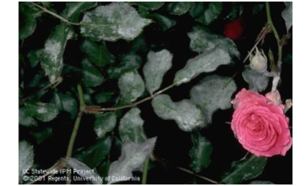
Fungicides: powdery mildew & other foliar diseases
* Sulfur formulated with soap
(NOT DUST)
* Biologiclas: Bacillus subtilis
* Neem and other oils(1)
* Potassium bicarbonate
(Cooper fungicides are organic:
used primarily in the dormant seaon)
(1) Oils are the most effective against foliar diseases and are the only ones that have eradicant activity

Slide 21
Insecticide and their restrictions
Remark | Insecticide | S.NO
Banned(for use in agriculture) 1989 | DDT(oc) | 1.
1990 | Endrin | 2.
January 1997 | HCN | 3.
Restricted 1999 | Parathion | 4.
Restricted 2001 | Methyl bromid | 5.

Slide 22
Right-to-know
* Pesticides must be labeled. The “label” includes the actual label on the container and literature that comes with the pesticide.
* Employees have a legal right to know what chemicals they may be exposed to and to review that “label” or Material Safety Data Sheets for those chemicals.
* A pesticide label is a legal document.

Slide 23
INFORMATION on LABELS
* Ingredient statement *Classification-Restricted or non-classified
* Name & address of
registrant * Signal Word
* Brand or trade name * Registration & establishment numbers
* Net weight or measure
of content * Directions for use
* Other information

Slide 24
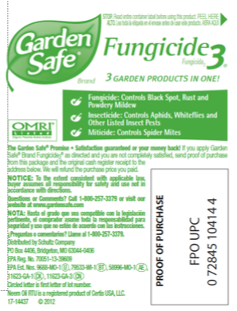
Herbicides Used in Organic Systems
* Products and brand identification
* Active ingredients
* Directions for use
* Precautionary statements
* Hazard to Humans, Domestic
animals and the Environment
* First aid instructions
* Note to physicians
* Storage and Disposal

Slide 25
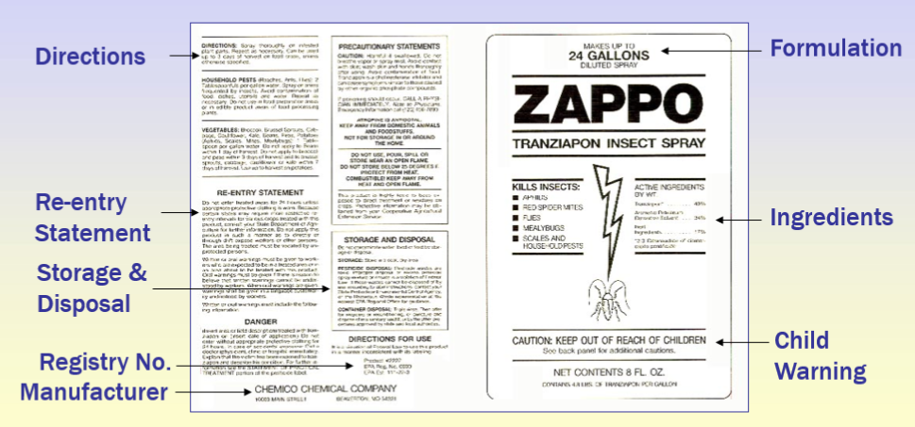
Sample Pesticide Label

Slide 26
TOXICITY
The capacity of substance to
produce injury or death.

Slide 27
HAZARD
The probability that an injury will
Result from the use of the pesticide
(involves both toxicity and
exposure).

Slide 28
RISK = TOXICITY X
EXPOSURE

Slide 29
Pesticides
* LD₅₀ = dose (oral or dermal) needed to kill 50% of a population of a lab test animal measured in mg/kg of body weight.
-LD=lethal dose
Want to see what taking in a milligram per kilogram for your body weights amount to?
It’s the equivalent of 726 people each weighting 150 pounds, sharing a chocolate bar (~50grams)

Slide 30
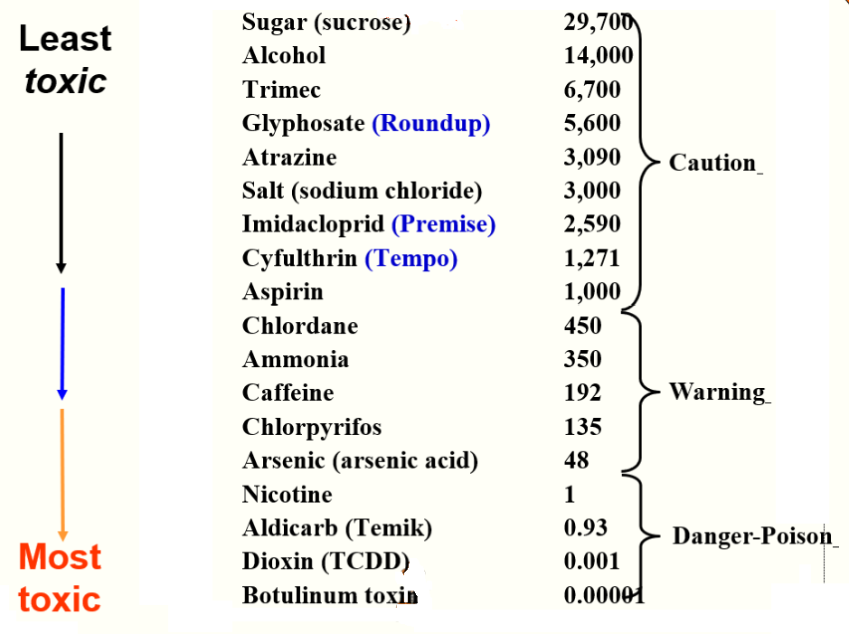
Relative Toxicity, rat LD50, mg/kg

Slide 31
Pesticides In Food Chain
* Safety checks are in place to limit exposure to pesticides in food crops.
* To be used on food crops many tests must be done to determine the safety factor.
* One of the largest cost of registering a pesticide.

Slide 32
RESIDUE
* Used to be measured in ppm
* A step in a journey of 568 miles.
* Or one minute in two years.
* Now measured in 0.1 ppm or measured in ppb
* To give you an idea of how little this would be, a pinch of salt in 10 tons of potato chips is also a part per billion.
* 1 penny in 10 million dollars
* 1 second in 32 years
* 1 foot of a tip to the moon
* 1 blade of grass on football field

Slide 33
RESIDUE
* EPA sets residual level - tolerance
* FDA enforces the tolerance

Slide 34
Signal Words indicate acute toxicity
Approx Human lethal dosage | Toxicity | Signal Word
Drop to a teaspoon | Highly toxic | Danger - Poison
Pesticide-specific | Highly hazardous | Danger
1 teaspoon-1 oz | Moderately toxic | Warning
1 oz to relatively nontoxic | Low toxicity | Caution

Slide 35
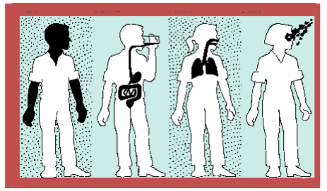
Pesticide Toxicity
* Toxicity is the ability of a pesticide
to injure a living organism
* ALL pesticides are toxic to some
organism
* DOSE: More toxic pesticides cause
harm at lower doses that less toxic
pesticides.

Slide 36
Pesticide Toxicity
The risk of pesticide depends on two things, exposure
(how much?) and toxicity (how poisonous?):
The exposure is the amount you get in or on your body, or
the amount that is released into the environment.
The Toxicity of a pesticide is measure of how poisonous it is
to people or environment.
Even products that are low in toxicity can be hazardous if the
exposure is high enough.
Most Pesticides will have either the word CAUTION, WARNING, or DANGER on the label, and that signal word reflects the toxicity of the product:
Caution represents the lower toxicity products
WARNING indicates medium toxicity products
DANGER stands for the highest toxicity products

Slide 37
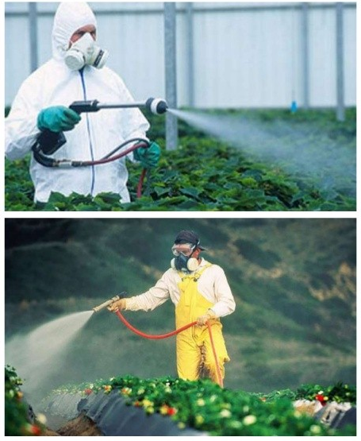
Minimizing Pesticide Risks
Adopt an Integrated Pest Management (IPM) approach: prevention, sanitation and exclusion, and utilizing pesticides only as a last resort when other options have failed.
Choose the product lowest in toxicity.
Choose products with formulations least likely to lead to exposure.
Use PPE to reduce your exposure.
Use the appropriate amount of pesticide for your job.
Avoid allowing children, pets, or sensitive people in treatments areas.

Slide 38
How Pesticide Enter the Body
* Absorption through skin – dermal (includes eye)
* Absorption through mouth and stomach (oral)
* Absorption through the lungs - inhalation

Slide 39
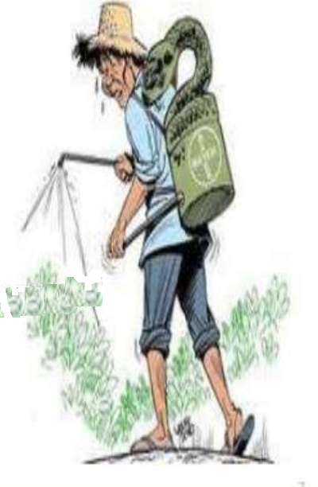
HARMFUL EFFECTS OF
PESTICIDE RESIDUES
* To HUMAN
* short-term impacts
* endocrine disruption
* Acute dangers
* Chronic health effects
* can cause many types of cancers

Slide 40
HARMFUL EFFECTS OF
PESTICIDE RESIDUES
* To Environment
* Accumulate in water systems
* Pollute the air
* Harming beneficial insects species, soil
microorganism, and worms.
* Weakening plant root systems and
immune systems.

Slide 41
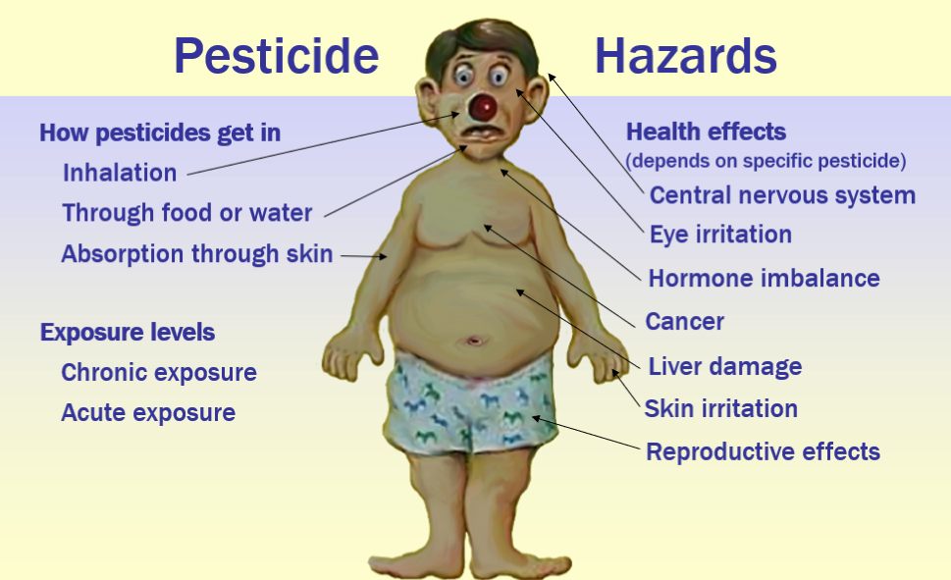

Slide 42
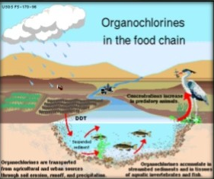
Specific pesticide effects
* Organochlorine DDT/DDE
* Egg shell thinning in birds
* endocrine disruptor
* Acute morality attributed to inhibition
of acetylcholine esterase activity
* Organophosphate
* Thyroid disruption properties in rodents, birds, amphibian
* Acute morality attributed to inhibition
of acetylcholine esterase activity
* Reduce metabolic functions such as thermoregulation

Slide 43
* Carbamate
* Interact with vertebrate immune systems
* Reduce metabolic such as thermoregulation
* Acute morality attributed to inhibition
of acetylcholine esterase activity
* Parathyroid
* Toxic to beneficial insects such as bees and dragonflies
* Toxic to fish and other aquatic organism

Slide 44
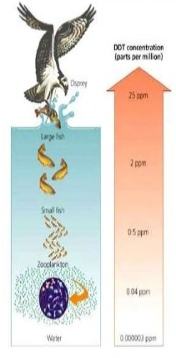
Specific pesticide effects
* If any individual continuously eat contaminated food it will accumulate in the body.
* All individuals are part of food chain as a result, toxins stores in the fats & oils pass one trophic level to next trophic level
* The higher up the food chain more concentrate the pesticide called biomagnifications.
* This is danger expose to human because they are also in top of food chains.

Slide 45
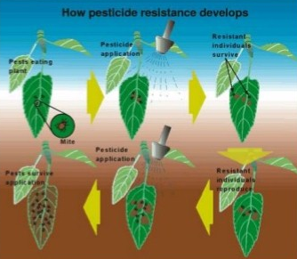
Resistance development
* When pesticide use long period of time, some pest become resistance to the pesticide.
* Because of resistance development pest can not be control
* Farmer have to increase the concentration or change the pesticide it make more & more environmental effects.

Slide 46
Food safety Risk analysis
* It refers the level of acceptable risk by different nations.
* European community- considering zero risk factor in food.

Slide 47
What are residues and why do they turn up in our food?
* Pesticides may be used in variety of different ways during the production of food:
* used by farmers to control the growth of weeds, or prevent crop damage by insects, rodents and molds.
* used on food crops after harvest to prolong their storage life
* used on animal farms to control insect pests
* When a crop in treated with pesticide, a very small amount of the pesticide, or its ‘metabolites’ or ‘degradation products’, can remain in the crop until after it is harvested. This is known as the ‘residue’.

Slide 48
* Residues can arise from:
* the use on crop of legally allowed pesticides according to good agricultural practice- (leave smallest and acceptable amount of residue
* Overdose of pesticide, or use too close to harvest, of a legally permitted pesticide
* illegal use of pesticide that is not approves that crop
* incorrect use of pesticides after harvest, to reduce pest infestation in storage or in transit.

Slide 49
* Residues residues may be present in:
* fresh or tinned fruit and vegetables, or
* processed food and drink made from the crop (e.g. juice, bread or any other manufactures food or drink), or
* fresh or processed animal products (if the animals have been fed on crop treated with pesticide).
* Occasionally, residues may also result from environmental or other ‘indirect’ sources.(e.g. residues of old pesticides, such as DDT).

Slide 50
Do Processed Foods Have Less Pesticides Than Fresh Foods?
* Generally, yes.
* Reason:
* Growers who have contracts with processors often don’t need to ensure that their foods are cosmetically perfect, and this allows them to omit some pesticide treatments, including some late-season insecticide applications.
* Many processors, responding to consumer demand for foods with minimal pesticide residues, have contracts with growers that specifically limit pesticide applications.
* Processing itself also often involves washing, peeling and cooking the food, steps that all tend to reduce pesticide residues.

Slide 51
What about organic food?
“When present, residues in organic foods are likely to be at lower levels that those in non-organic foods.” (Baker et al.)

Slide 52
Health effects of pesticides
* Birth Defects
* A study in Minnesota found significantly higher rates of birth defects in children born to pesticide applicators and in regions of the state where chlorophenoxy herbicides and fungicides are widely used. (Garry, 1996)
* In California, mothers living and working in agricultural areas with pesticide use had a higher risk for giving birth to children with limb reduction defects. (Schwartz, 1988)
* A study pf pregnant women in Iowa and Michigan found that women exposed to multiple pesticides had an increased risk of giving birth to a child with cleft palate(Gordon, 1981)

Slide 53
Health effects of pesticides
* Neurological effects
* Long term exposure can result in reduced IQ and learning disability, associated with permanent brain damage.
* A study in Mexico shows that children living in area with high levels of pesticide exposure had less stamina, poorer eye-hand coordination, poorer memory and were less skilled in drawing figures. (Guillette, 1998).
* The risk of developing Parkinson’s disease is 70% greater in those exposed to even low levels of pesticides (Ascherio et al, 2006).
* There are also concerns that long term exposures may increase the risk of dementia. (Baldi I et alm 2010)

Slide 54
Health effects of pesticides
* Cancer
* Associations have been found with” leukemia, lymphoma, brain, kidney, breast, prostate, pancreas, liver, lung, and skin cancers
* Sheila Zahm and Mary Ward, summarized the studies of pesticides and childhood cancer and concluded that the following childhood cancers were linked to pesticide exposure: leukemia, neuroblastoma, Wilms tumor, soft-tissue sarcoma, Ewing’s sarcoma, non-Hodgkins’s lymphoma, and cancers of the brain, colorectum and testes. ( Zahm and Ward, Environmental Helath Perspectives, vol. 106)

Slide 55
Health effects of pesticides
* Fertility
* A number of pesticides including dibromochlorophane and 2,4-D has been associated with impaired fertility in males. ( Sheiner EK et ak, 2003)

Slide 56
Prevention and Control
* Consumer’s education:
* Choose foods frequently that low TI values.
* Choose foods with the highest TI values, such as peaches, less often. Eating these foods occasionally is unlikely to do such harm, but eating multiple servings in a short time probably should be avoided.
* Look for organically grown food.
* Remove the peel. Many pesticide residues are on the outside of a fruit. Removing the peel can dramatically lower pesticide exposure associated with these foods.
* Choose processed foods more often, especially those for which TI are substantially lower than for fresh varieties of the same foods, such as canned peaches.

Slide 57
* Legislative approaches:
* Pesticide Act 1974 which is implemented by a Pesticides Board, That has the Department of Agriculture (DOA) as its secretariat is the main Act that controls pesticides
* the Food Act 1983 and the Food Regulations 1985 and (Amendment 1955) control pesticide residues in food and are enforced by Ministry of Health;
* Pesticides (Registration) Rules 1976 will ensure that the pesticide imported, manufactured, and sold in the country are of acceptable quality not causing unacceptable, adverse effects on human health and the environment.

Slide 58
* Monitoring residue:
* Food Quality Control (FQC) unit and DOA – collect fresh produce at farm gate selling points and send it for residue testing
* If exceed MRL, growers could be charged under Food Act and Regulations
* Standards for residue:
* National standards – Food regulations 1985 (Sixteenth schedule)
* International standards - CODEX Alimentarius

Slide 59
* Non-legislative and other approaches:
* research into biopesticides by research institutions;
* implementation and promotion of integrated pest management (IPM), such as the use of barn owls to control rats in paddy fields;
* research into alternative pest control methods;
* introduction of better pesticide application technology;
and
* promotion of alternative farming methods, including organic farming and hydroponics for the production of vegetables.

Slide 60
* It is essential to promote bio-farming, for a healthy generation and also for the protection of our environment for the existence of all organism on earth.

Slide 61
